Slide 1

Backend .Net - ROD
Support training

Slide 2



Soy Bruno Targhetta, Development Consultant .Net de Endava.
Vengo trabajando con tecnologías Microsoft desde hace mas de 15 años. Siempre colabore con procesos de capacitación.
Soy Papa de Lucio, fanático de River, practico un poco de ciclismo y de mirar mucho Desafio sobre el fuego, arranque a hacer cuchillos en mi taller como hobby.
@spinnaker_84
brunotarghetta

Slide 3

1
Bench activites
Beginers Course

Slide 4
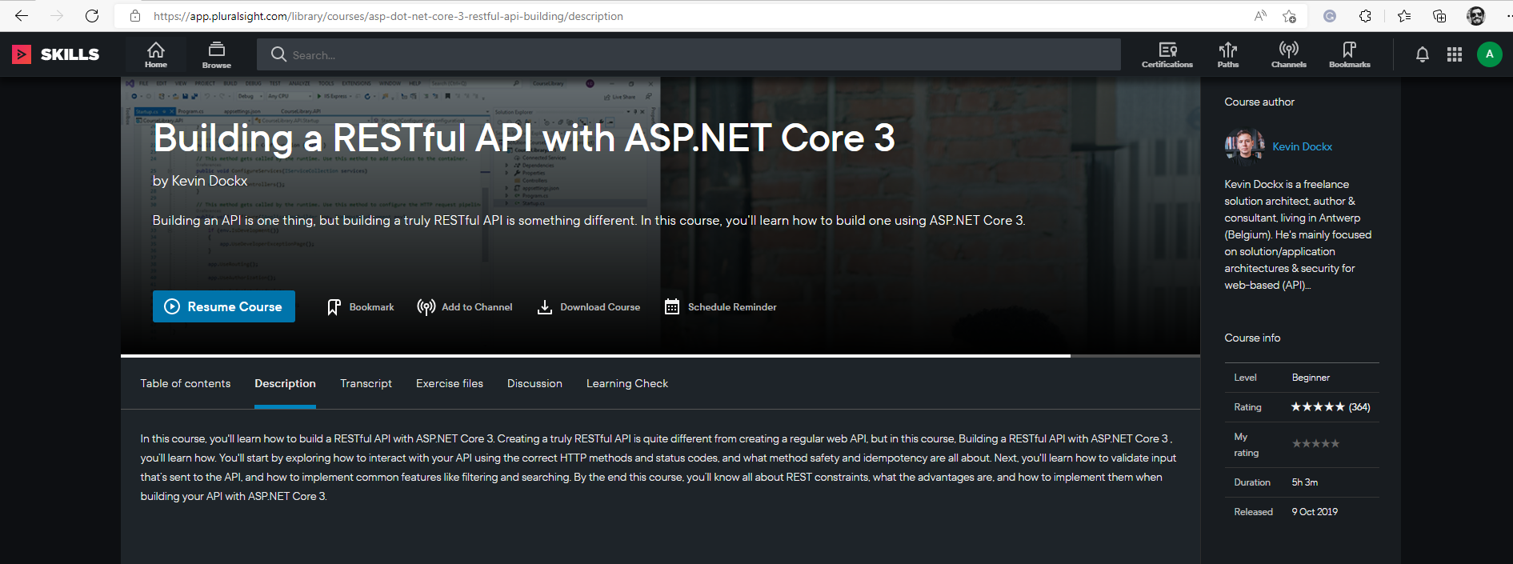
E-learning course - Pluralsight

Slide 5
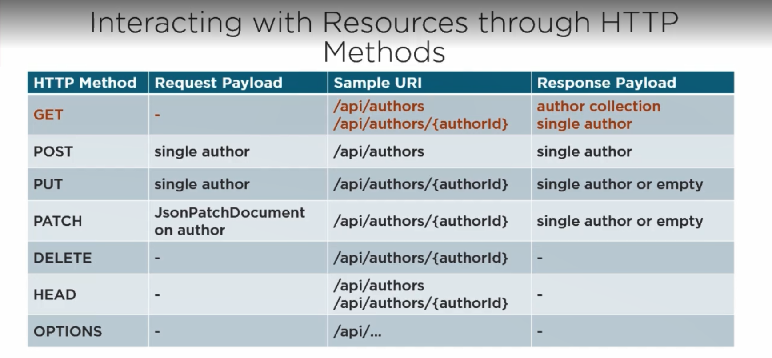

Slide 6

CLIENT NAME Services Proposal - 4. Data
Interacting with your API
Topics that course include
Method safety
Validating inputs that’s sent to API
Features like filtering and searching

Slide 7

Content
Building a restful API with ASP.Net core
Course overview
Getting started with REST
Structure and implementing facing contract
Getting resources
Filtering and searching
Creating resources
Validating data and reporting validation Errors
Updating resources
Deleting resources
Extras activities
Logging and Unit Testing
Notes:
Agenda
General Template Guidance: Information to help you make good presentations.
Standard / Static Slides: Some key Endava slides/lockups that, in general, should only be modified by marketing.
Template Slides: A selection of template slides for use in Endava presentations.
Larger Format Template Slides: Template slides with larger content.
Icon Library: A selection of hundreds of icons to use in Endava presentations.

Slide 8
Bench activity Backend .Net - Beginer course
Summary
Repo Git: https://github.com/brunotarghetta/CourseLibrary
Pluralsight: Building a RESTful API with ASP.NET Core 3
Request Access to pluralsight: E-Learning (sharepoint.com)
Technologies stack is based on Wellsky client.
Each module will have a class to validate knowledge after the class sees the video and code what the module propose.
After the course attendee will have knowledge of: Aspe.Net API, REST, Dependency injection, Data annotation, Fluent Validation, Automapper, Postman, UnitTest, logging, Entity Framework.
Version Check:
ASPNet Core 3
Visual Studio
Entity framework core 3.0
Notes:
One pager Case Study Template 1 – with 3 achievements

